Slide 1
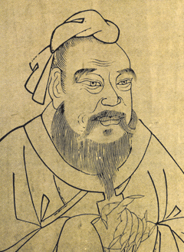
Neo-Confucianism

Slide 2
Parent
Confucianism
Child
Neo-Confucianism

Slide 3

What is
Neo-Confucianism

Slide 4
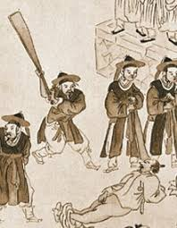
Neo-Confucianism is
An ideological system that rationalizes justifiable order.
It is the moral duty for human to live in harmony
ME

Slide 5

1
Neo-Confucianism
is
TOOL

Slide 6


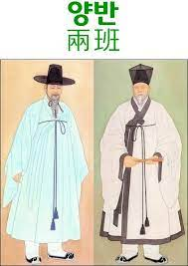
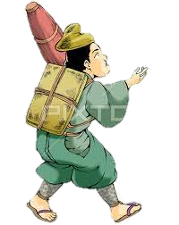
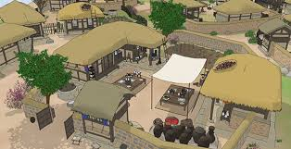
Joseon Dynasty in middle age
Neo-Confucianism

Slide 7

WHY?
Joseon Dynasty in middle age
Merchant

Slide 8
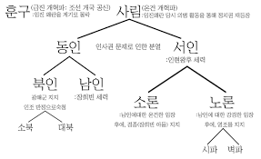
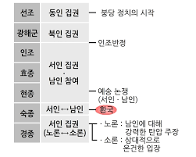
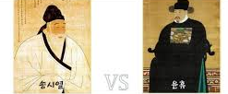
Joseon Dynasty after 1600 year
Neo-Confucianism

Slide 9
2
Sexism
Is a tool of
Neo-Confucianism

Slide 10
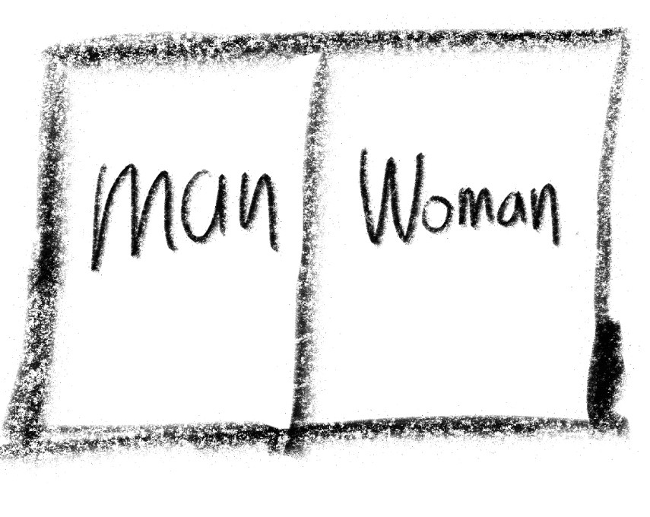



Slide 11

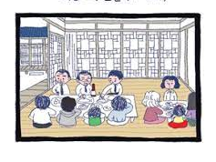
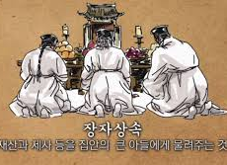
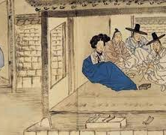
Neo-Confucianism
Sexism

Slide 12
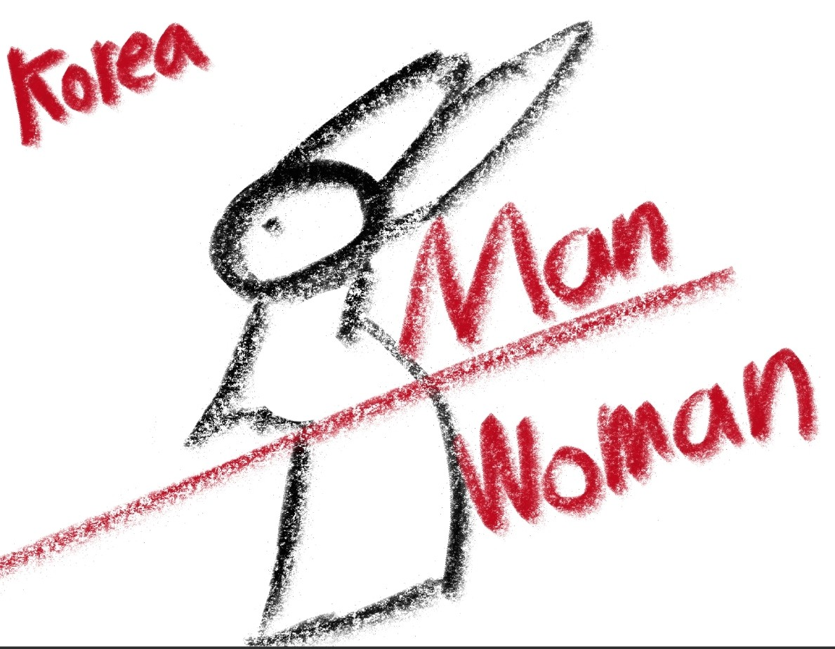
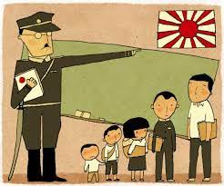
the height of Sexism

Slide 13
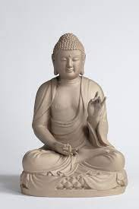
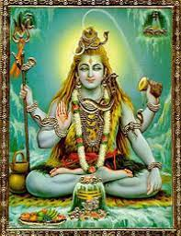

Buddhism
God.
Allah.
Neo-Confucianism
.
For profit
TOOL

Slide 14

This is only my thought.

